Slide 1
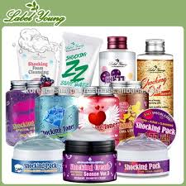
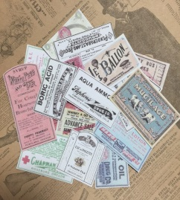
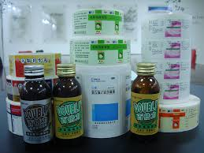
For meeting purpose only
What is advantage of SwiftColor compared with our competitors?
The minimum media width and length are much different.
The differences among three printers are as follows.
Our target
small size media
2inch (w)
2inch(w)
0.236inch(6mm)(L)
1inch (L)
1inch (L)
1inch (w)
EPSON
TM-C7500
Memjet
VP700
SwiftColor
SCL-4000
Medicine
manufacture
Cosmetic
manufacture
Food
manufacture

Slide 2
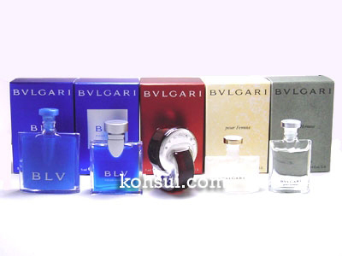
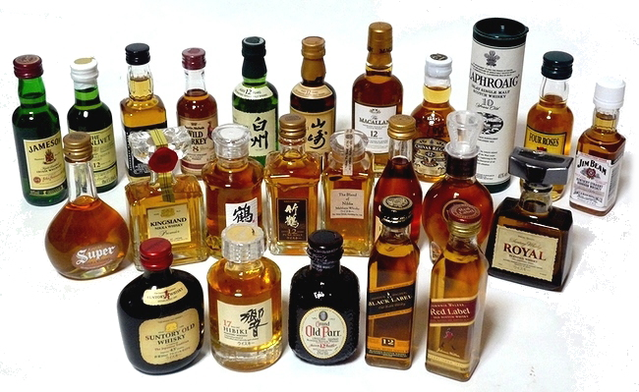
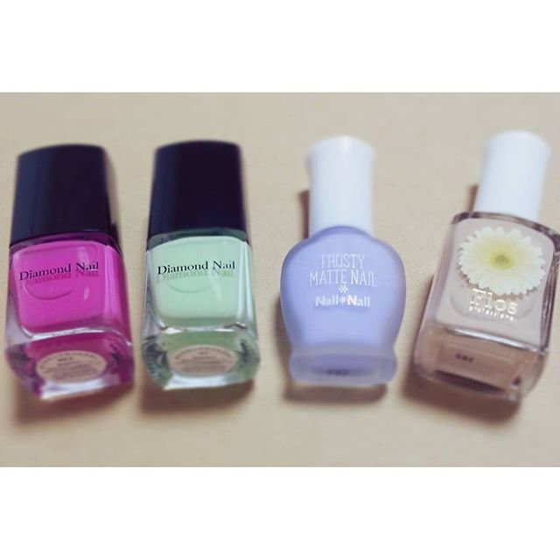
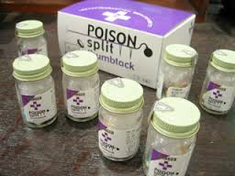
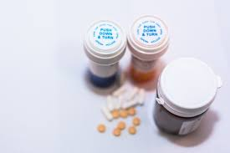
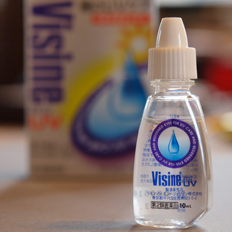
Small bottle of perfume.
Small bottle of liquor.
Small bottle of cosmetic.
Some examples of our target.
※If some of them ring a bell, please contact and recommend
them SwiftColor with our advantage.
※ Please do not send the information to any other companies.
Small bottle of
internal medicine.
Small bottle of
Internal medicine.
Small bottle
of eye drop.

